Slide 1
Navigating Async Challenges in EF Core for Large Data Retrieval
Saeed Esmaeelinejad

Slide 2






Senior Software Engineer at
Connect with me
Microsoft MVP
Saeed Esmaeelinejad
Feel free to send me a message

Slide 3
Agenda
01
02
03
Explain the scenario
Benchmarks and the numbers
Where the issue comes from?
04
05
06
What to do to for the better?
Benchmarks and see the numbers after applying the solutions
Ending!

Slide 4
01
Explain the scenario

Slide 5
In EF Core, Async operation is much slower than Sync operation when dealing with Large data set.

Slide 6
The reasons to have large data set: - Varchar(max) - Varbinary(max) - Many rows (not focused here)
Use-cases: - Properties we don’t know about the length - Storing files!

Slide 7
02
Benchmarks and the numbers

Slide 8
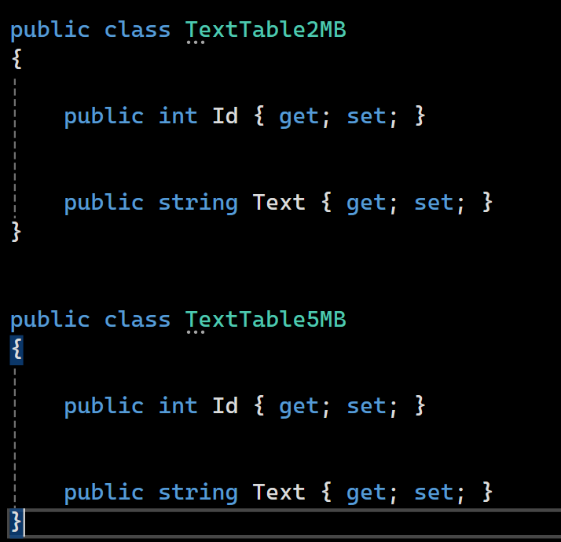
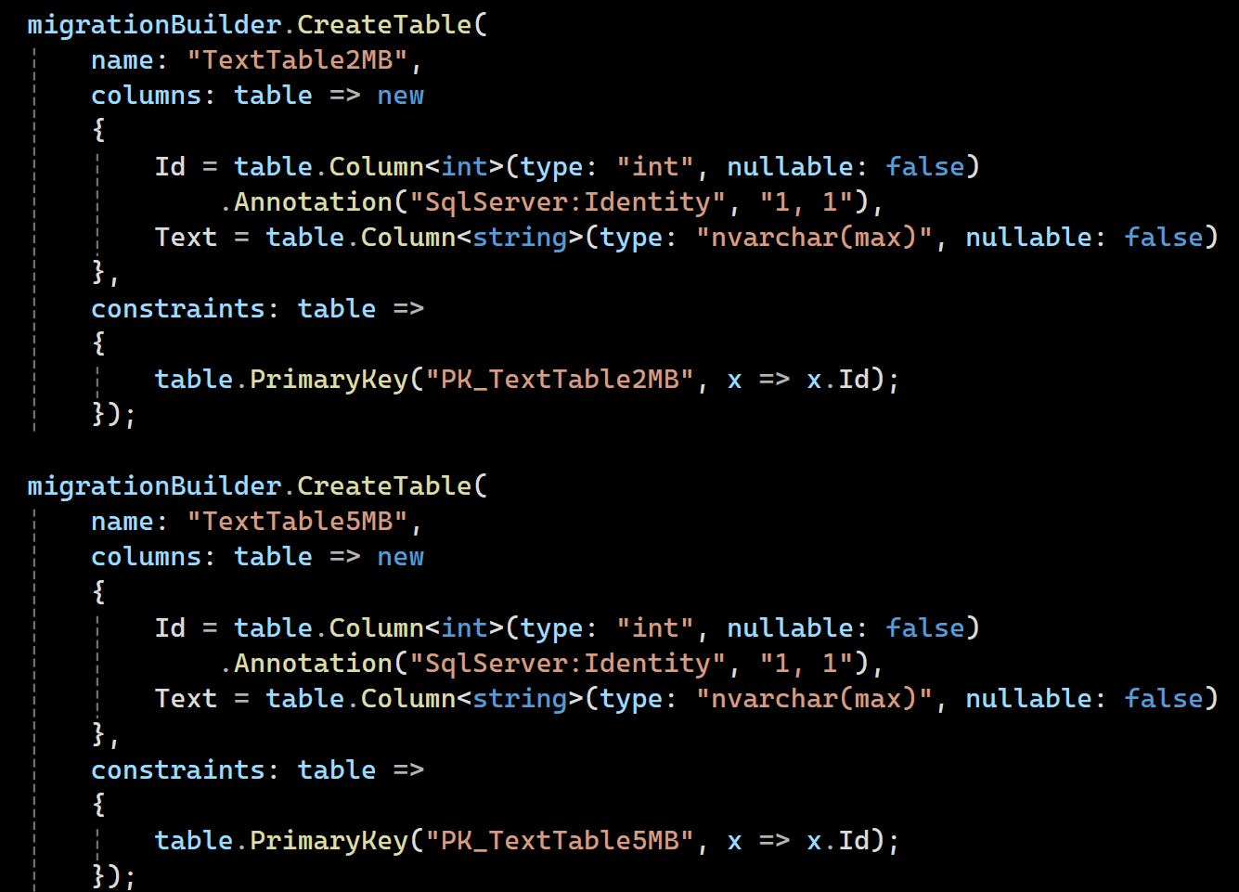
Entities & Tables
dotnet ef migrations add “init”

Slide 9
Let’s see the Benchmark code

Slide 10
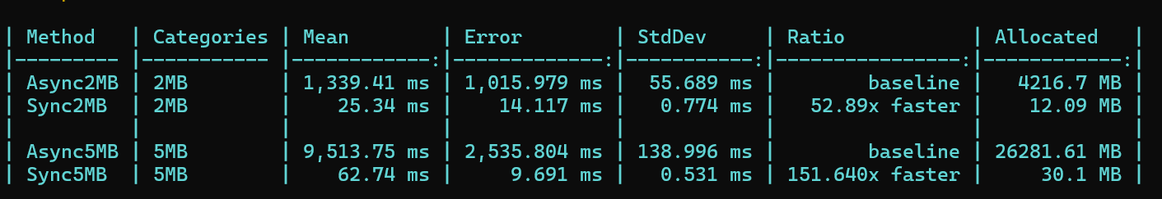
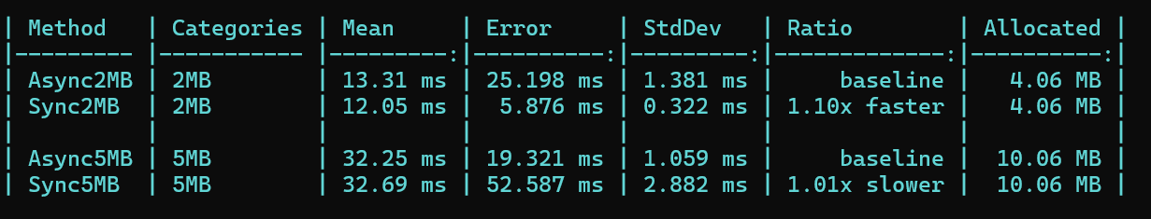
The numbers (EF Core 9-rc2)
SQL-Server
Postgres

Slide 11
03
Where the issue comes from?

Slide 12
Question: Could EF Core actually be the culprit when using Sql-Server provider?
Will see!

Slide 13
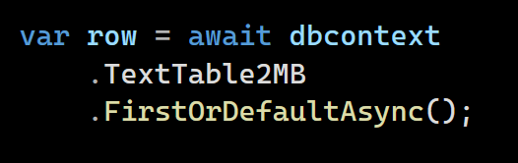
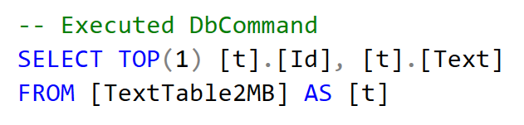

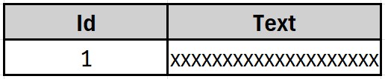
How does EF Core execute a query?
LINQ query translator
Database provider
Microsoft.Data.SqlClient
Microsoft.EntityFrameworkCore.SqlServer
- Create classes
- Relations fixup
- …
MS-SQL
TextTable2MB
TextTable2MB

Slide 14
How to find which version of SqlClient is using in EF Core?
There is a new feature in .NET 9:
“dotnet nuget why”
Notes:
Go to the code

Slide 15
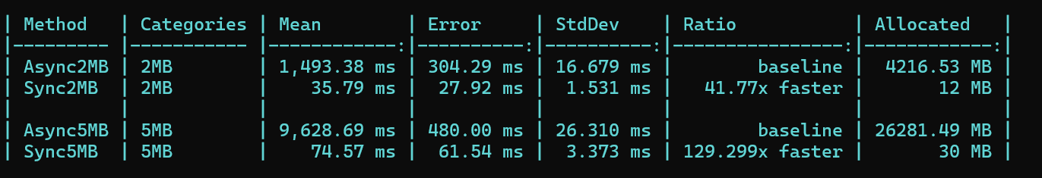
The benchmark result for SqlClient 5.1.6

Slide 16
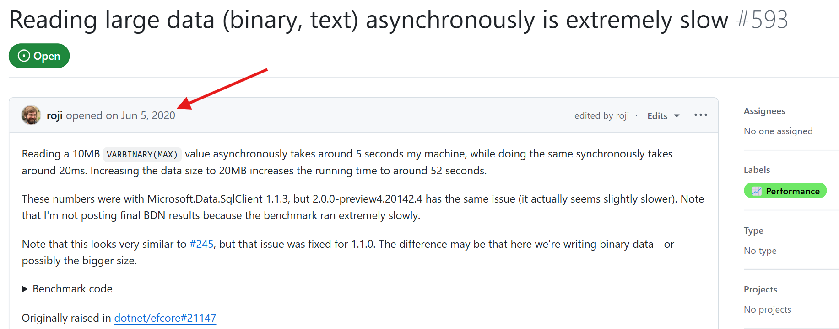
The reported issue in the SqlClient repo

Slide 17

How SqlClient is dealing with SqlServer?
Application Side
LINQ query translator
Database provider
MS-SQL
- Create classes
- Relations fixup
- …
TextTable2MB
Using Tabular Data Stream (TDS)
protocol to exchange packets.
TextTable2MB

Slide 18
How TDS works
The Tabular Data Stream (TDS) protocol enables request and response transfers between clients and database servers over a long-lived connection, using TDS messages for client-server communication once connected.
TDS message format
Server:COLMETADATAdata stream
ROWdata stream
...
...
...
ROWdata stream
DONEdata stream
The result of a query will be streamed until whole response delivered each message size is 8KB means if the size of result is 5MB it needs 640 TDS messages to receive.
There should be a TDS parser on client side which is responsible to parse and aggregate all messages until response finished.

Slide 19
What is the main issue?
Implementing TDS parser for Async API causes much more memory allocation and, consequently, slower query.

Slide 20
04
What to do for the better?

Slide 21
Possible solutions:
1- Simply just use Sync methods over Async ones but with caution!

Slide 22
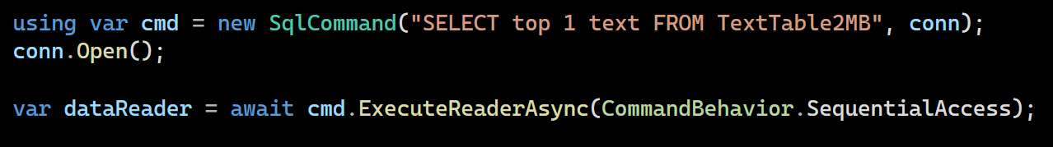
Possible solutions:
2- Using CommandBehavior.SequentialAccess if you’re using SqlClient package directly (ado.net)
SequentialAccess behavior provides a way to handle a row containing large binary value and helps DataReader to stream data rather than loading entire row which is the default behavior (CommandBehavior.Default).
Not possible to use in EF Core, already in process though: Github issue

Slide 23
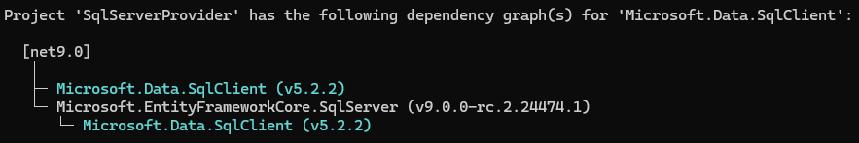
Possible solutions:
3- Update SqlClient package to the latest version and suppress the internal one in the EF Core

Slide 24
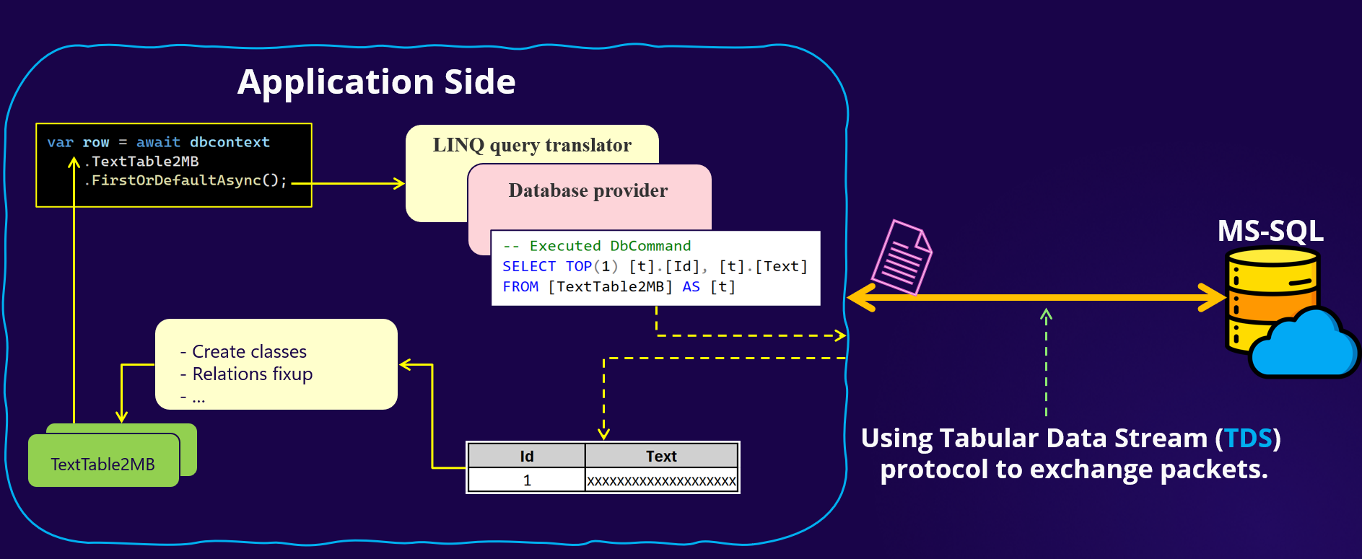
Possible solutions:
4- Increase packet size in the connection string for getting bigger data in TDS packets.
The default package size is 8KB but we can set it up to 32KB which the max allowed value.
"Server=localhost;Database=EFLargeDataDb;user id=**;password=***;Packet Size=32768"

Slide 25
05
Benchmarks and see the numbers after applying the solutions

Slide 26
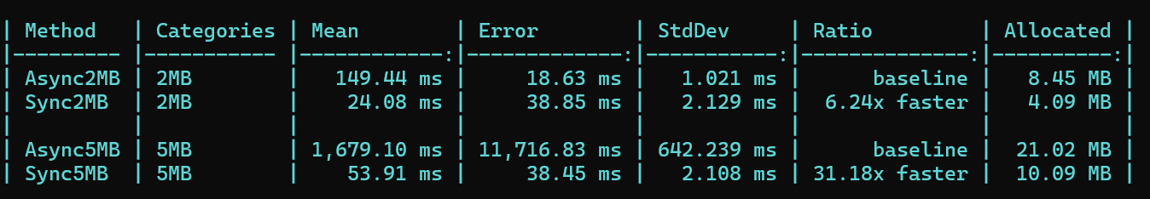
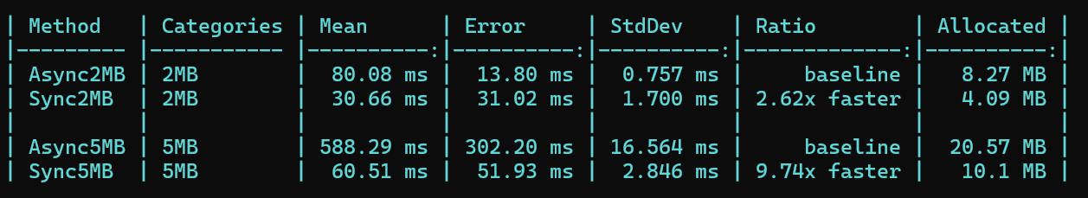
The numbers (EF Core 9-rc2)
Before
SqlClient 5.2.2 8.97x faster
SqlClient 5.2.2
& packet size
16.73x faster

Slide 27
06
Ending

Slide 28
Takeaways
Now, we know what is the issue with large data set in EF Core, where is it and how to fix it (partially).
Keep an eye on the Github issue and update your packages.
Always set max length for string properties, if possible, I would suggest to set a global max length for all strings otherwise override it.
If you have nvarcharmax in your database then it could be a security issue as well (DDOS attack).
Let’s remember this: EF Core is just an ORM can’t do the magic for us, we must know about the underlying database!

Slide 29
Resources
Github Repo
SqlClient repo
Github repo for this presentation contains all benchmarks
The reported bug in SqlClient repo
TDS protocol
TDS 8.0
Definition of TDS protocol
TDS 8.0 in SQL Server
TDS messages
Pull request to improve in SqlClient 5.2.2
TDS messages format
Pull request to improve in SqlClient 5.2.2
TdsParserStateObject
EF Core 9.rc2 issue
Where the memory is used a lot
EF Core 9.rc2 issue by using SqlClient 5.1.6

Slide 30
Thank you!
Connect with me
Microsoft MVP
Saeed Esmaeelinejad
Feel free to send me a message

